Slide 1
Lightning Introduction to Parallel Programming
David Lange
Princeton University

Slide 2
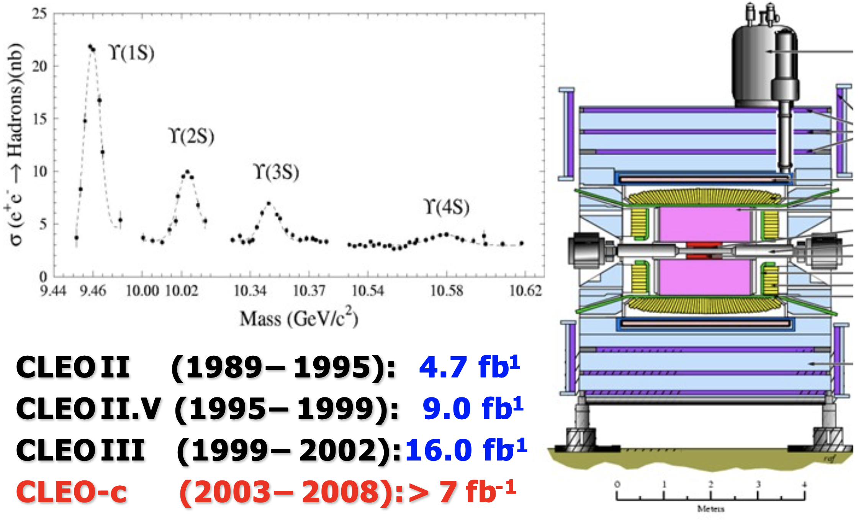
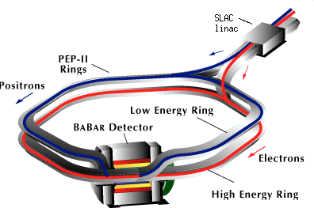
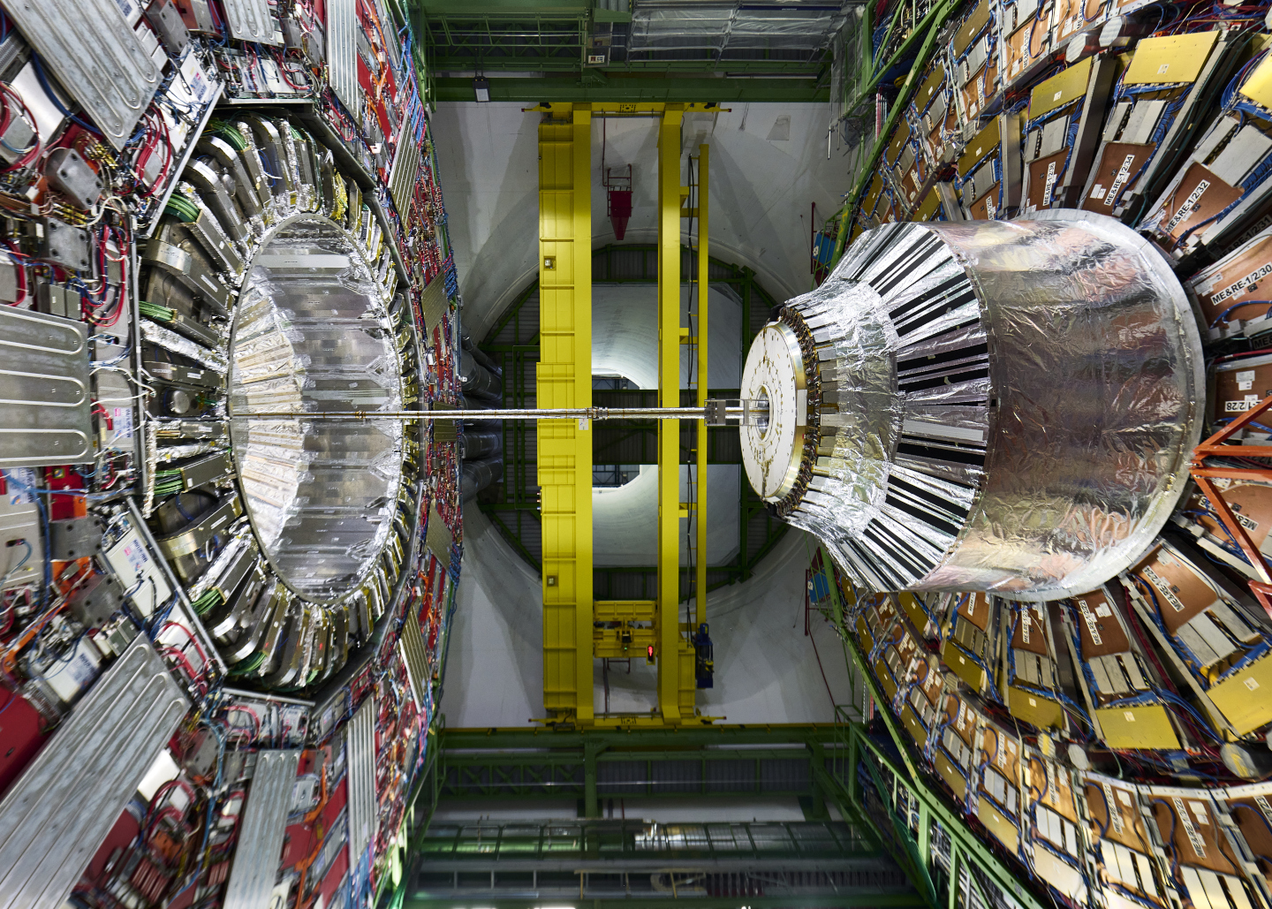
My career in high-energy physics
CLEO-II(.5) @ Cornell
BABAR @ SLAC
CMS @ CERN
Silicon detector calibration + operations
Form-factor analysis in semileptonic decays
Event generators
CP violation analysis
RPC detector operations + software
Event generators (“EvtGen”)
Event reconstruction software
Event reconstruction software
Simulation techniques
Computing resource projections

Slide 3
My Goal for Today
Why worry about parallel programming for science?
Considerations for high energy physics codes
Methods , approaches and hardware
Languages, tools and resources (likely to be skipped today)
Using GPUs with Python

Slide 4
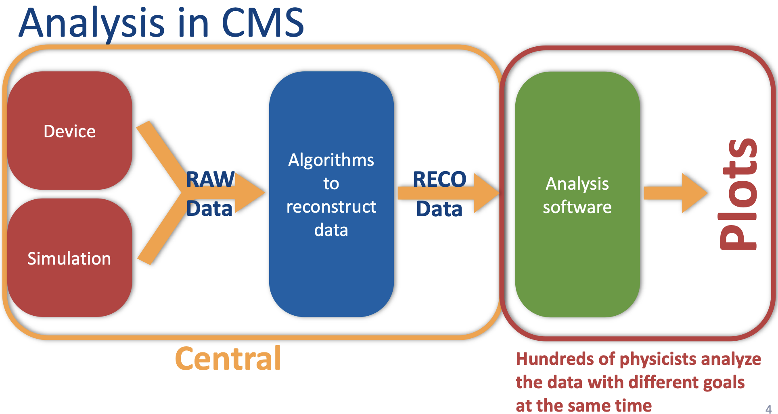
Bulk data processing vs time to insight

Slide 5
How can we get our science done faster or cheaper?
Reduce the complexity of algorithms in the application
Write better code
Consider approximations
Consider needed/appropriate numerical precision
Increase the speed and capacity of the compute
Increase clock frequency
Find tasks within the application that can be performed in parallel

Slide 6
How can we get our science done faster?
Reduce the complexity of algorithms in the application
Write better code
Consider approximations
Consider needed/appropriate numerical precision
Increase the speed and capacity of the compute
Increase clock frequency
Find tasks within the application that can be performed in parallel

Slide 7
How can we get our science done faster?
Reduce the complexity of algorithms in the application
Write better code
Consider approximations
Consider needed/appropriate numerical precision
Increase the speed and capacity of the compute
Increase clock frequency
Find tasks within the application that can be performed in parallel
We won’t talk about this today Efficient coding and optimization techniques can easily fill an entire course (or an entire career…)

Slide 8
How can we get our science done faster?
Reduce the complexity of algorithms in the application
Write better code
Consider approximations
Consider needed/appropriate numerical precision
Increase the speed and capacity of the compute
Increase clock frequency
Find tasks within the application that can be performed in parallel

Slide 9
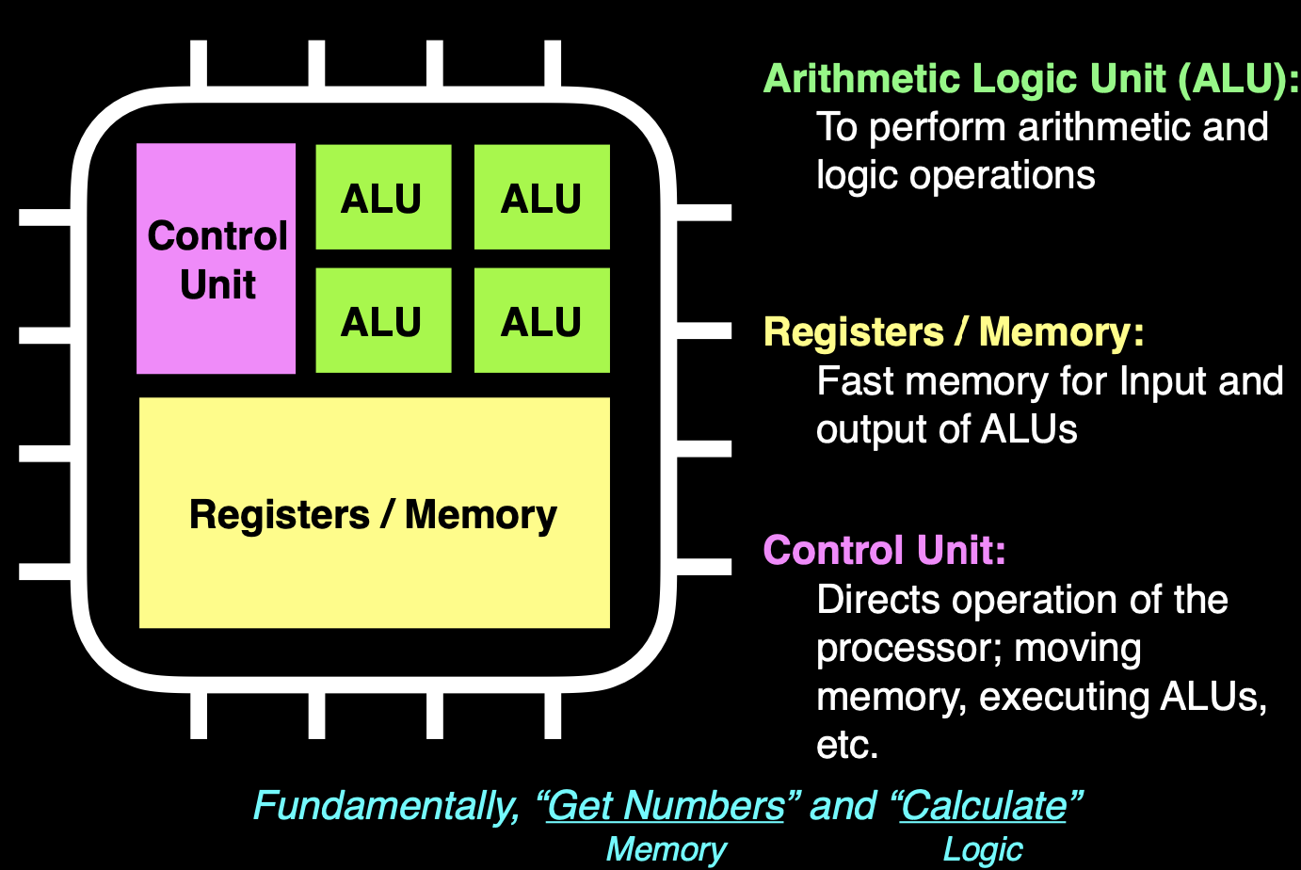
Central Processing Units (CPUs)

Slide 10
How to go faster?
More logic units in same space = more transistors
Faster clocking = higher frequency
I/O performance needs to keep up…

Slide 11
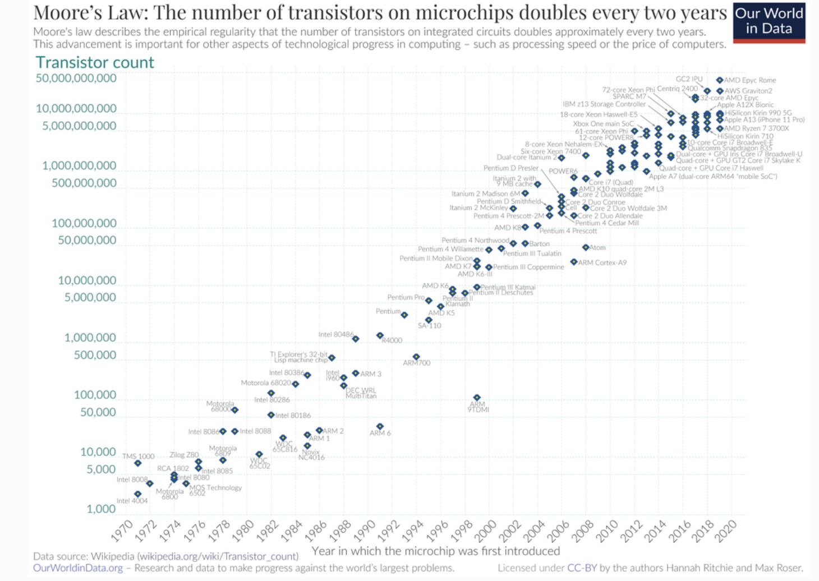
More transistors? Moore’s Law

Slide 12
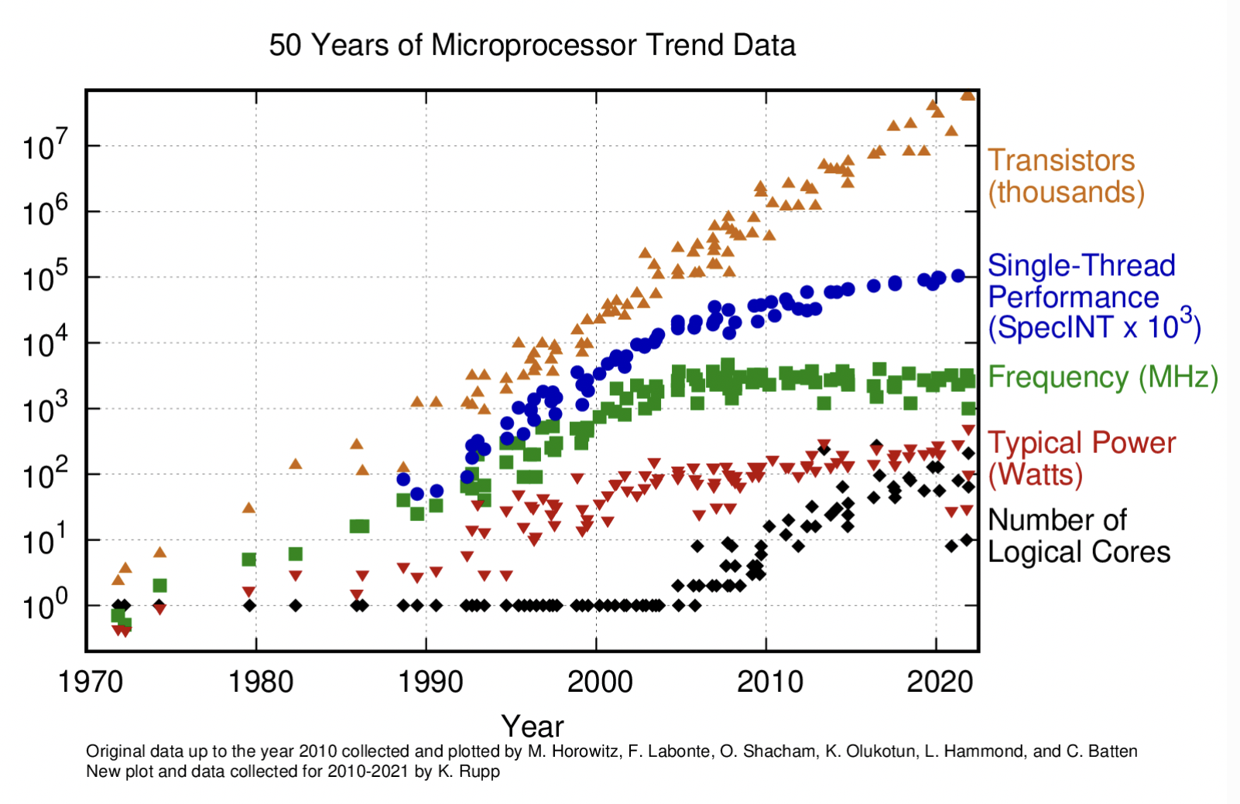
Trends in transistors to compute architectures

Slide 13
What happened in the early 2000s?
Dennard scaling suggested that each individual transistor in a new generation would be cooler and draw less power
Broke down in the early 2000s. This effectively stopped the continuous trend of clock speed increase in CPUs
Why?
More power per core brings two problems: more power (more money) to run the CPU and higher heat removal requirements (yet more power/money)

Slide 14
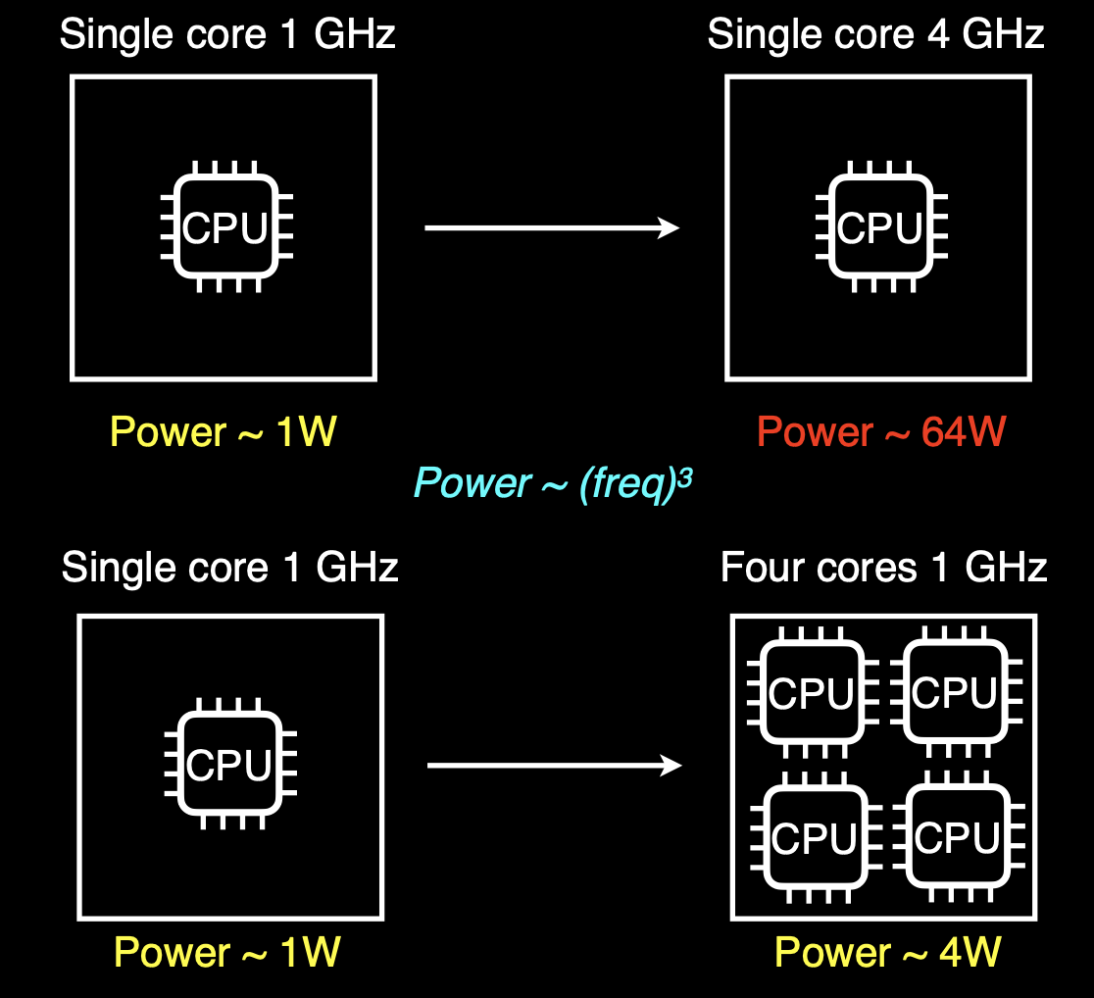

Slide 16
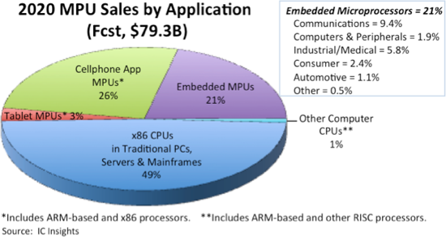
Data centers and low-power applications drive the market

Slide 17
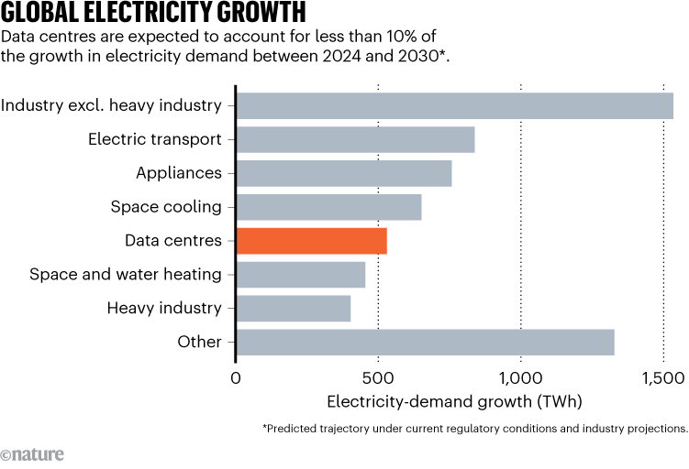
Power is a leading consideration in data centers (too)

Slide 18
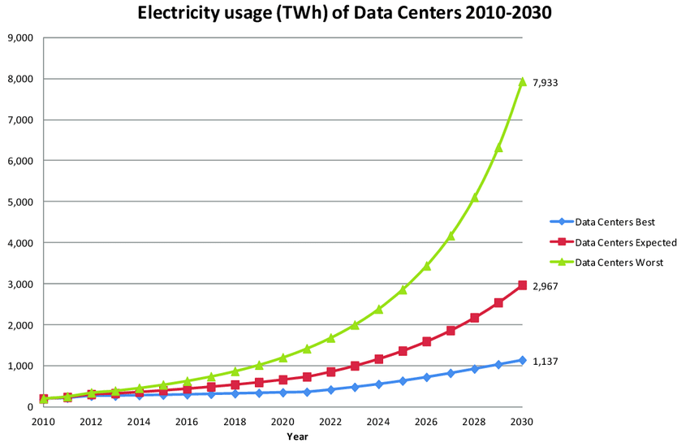
Just how important is energy in data centers?
Matching “best case” from projection made in 2015
http://dx.doi.org/10.3390/challe6010117

Slide 19
How can we get our science done faster?
Reduce the complexity of algorithms in the application
Write better code
Consider approximations
Consider needed/appropriate numerical precision
Increase the speed and capacity of the compute
Increase clock frequency
Find tasks within the application that can be performed in parallel

Slide 20
Parallelization of certain tasks of our program, so that they are executed simultaneously (threads)
For this it is necessary to:
Have parallel platforms where to run.
We just saw that this is not a problem. All modern compute is parallel to some extent
Adapt your application to be efficiently executed in parallel.
How easy is this?

Slide 21
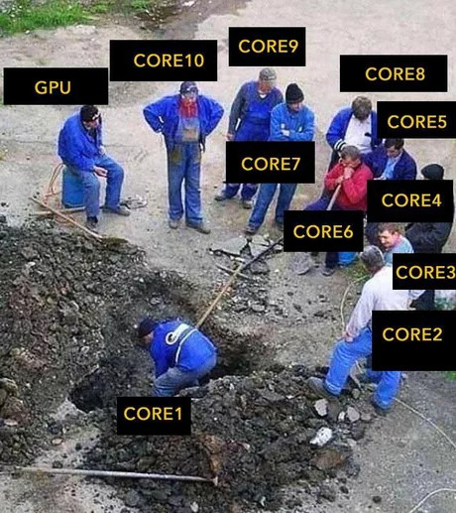
Parallel hole digging

Slide 22
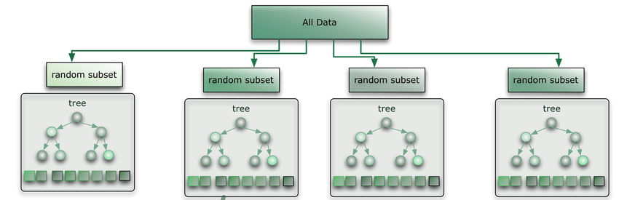
Why not just “embarrassingly” parallel?
HEP experimentalists have lots of events(100s of billions per year), and events can be analyzed independently.
Can’t we just write applications that do the equivalent of digging lots of holes?

Slide 23
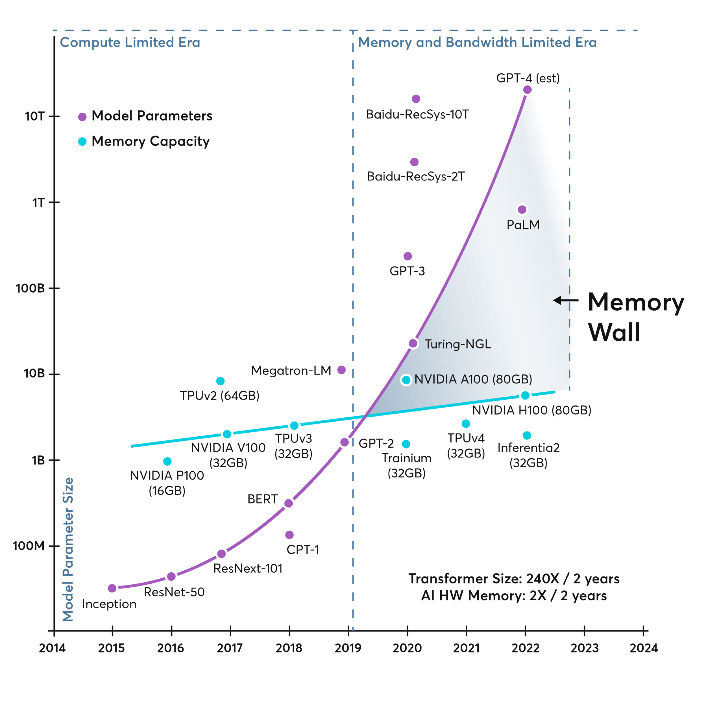
Memory demands out pace supply

Slide 24
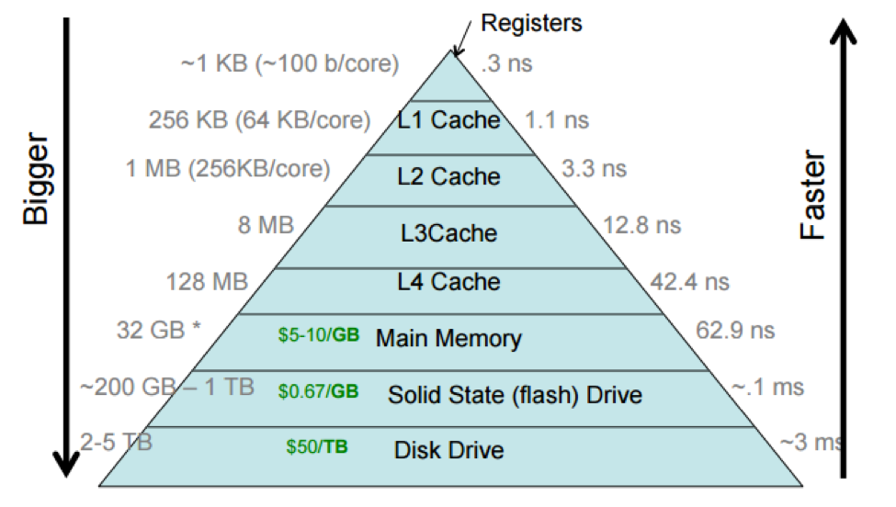
Another way to look at the importance of memory footprint
Memory efficient algorithms will run faster!

Slide 25
What does all this mean?
Science does not drive the market for modern computing, so we must adapt to market trends
To take full advantage of modern computing architectures, we need to think about building applications from algorithms that are capable of exploiting parallelism opportunities that speed up the application and allow it to use less memory

Slide 26
What does all this mean?
We have to ”think parallel” when writing code We should adopt parallel capable libraries to help us do that

Slide 27
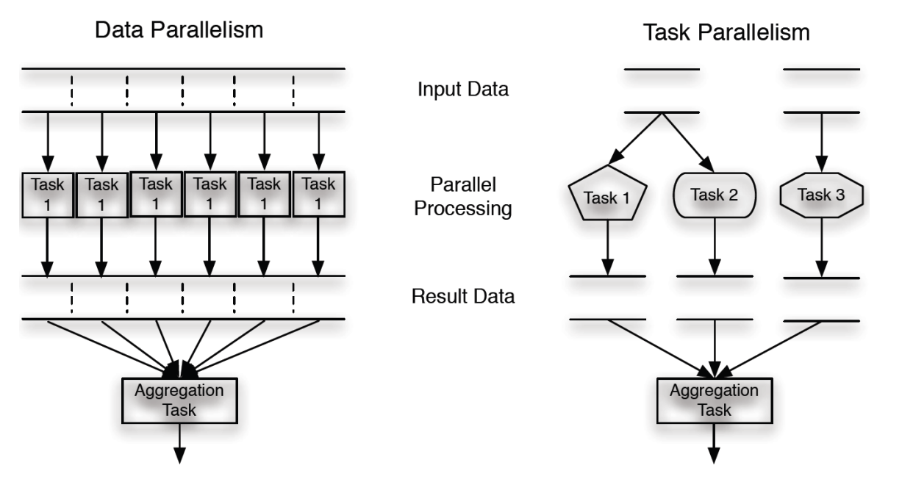
Task Parallelism and Data parallelism examples
https://medium.com/@geminae.stellae/introduction-to-parallel-computing-with-opencl-2ee91c30b8b6

Slide 28
Programming considerations
Tasks need to be able to run in parallel
Aggregation tasks are potential bottlenecks
Our approach may be different depending on if our application aims to minimize “time-to-insight” or to minimize “cost per event”

Slide 29
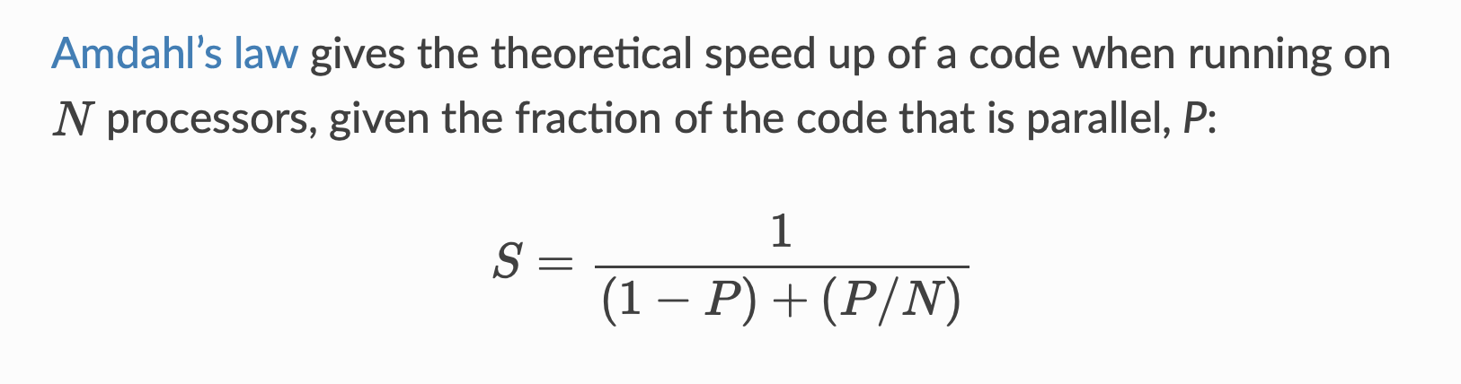
Amdahl’s “Law”: (P)arallel code fraction determines how much faster your application can go using N cores/threads

Slide 30
To use a 64 core CPU at high efficiency, how much of your application must be parallel?
50%
90%
99%
99.9%
99.99%
If you want to use 90% of the cores you need 99.9% parallel code in this case

Slide 32
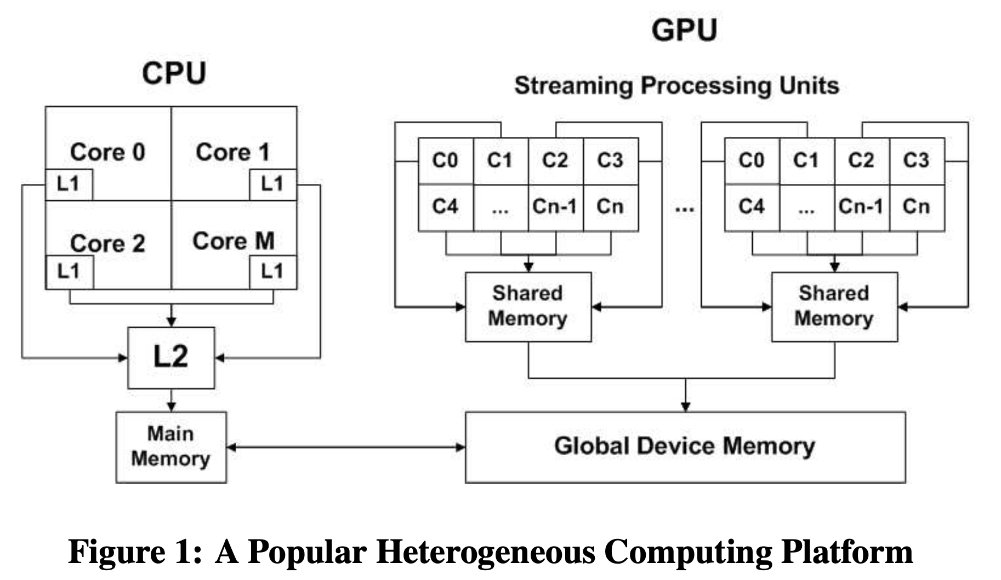
Heterogeneous computing

Slide 33
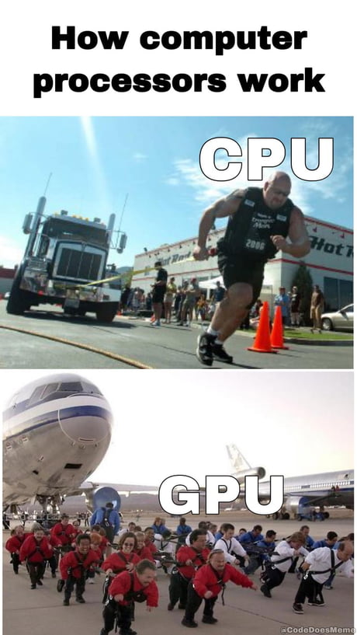
What is a GPU? Graphics Processing Units
The processor inside the graphics cards was purpose-specific for graphics only.
GPGPU: Programming techniques to enable the GPU as a parallel co-processor.
Currently: Intuitive programming and high number of processors (e.g. over 16000 cuda cores in RTX4090).

Slide 34
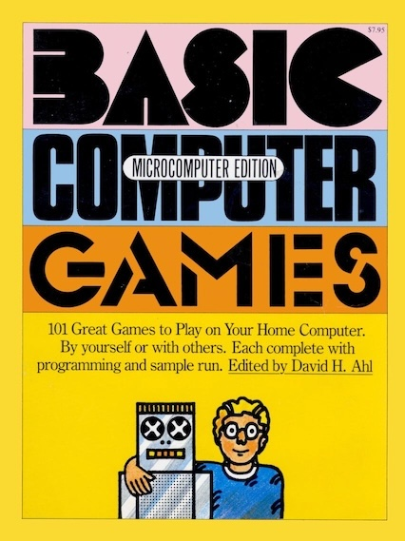

Wait aren’t GPUs for gaming?

Slide 35
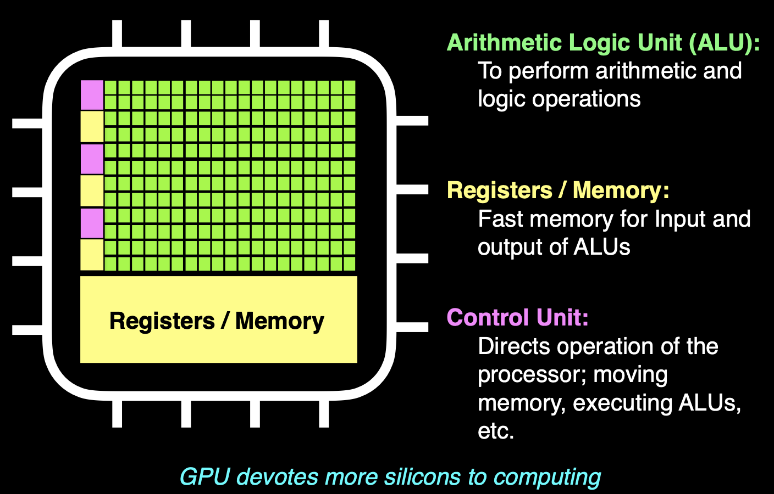

Slide 36
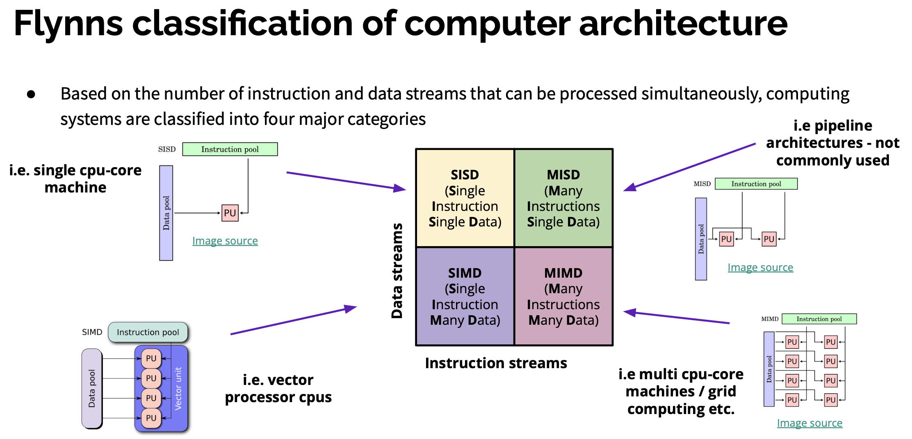

Slide 37
Other types of hardware accelerators
FPGA (Field Programmable Gate Array)
FPGAs can be reprogrammed to suit the needs of an application or required functionality
More about FPGAs later this week
ASIC: Integrated circuit customized for a specific purpose/application
TPU: Optimized to perform matrix-multiplication operations

Slide 38
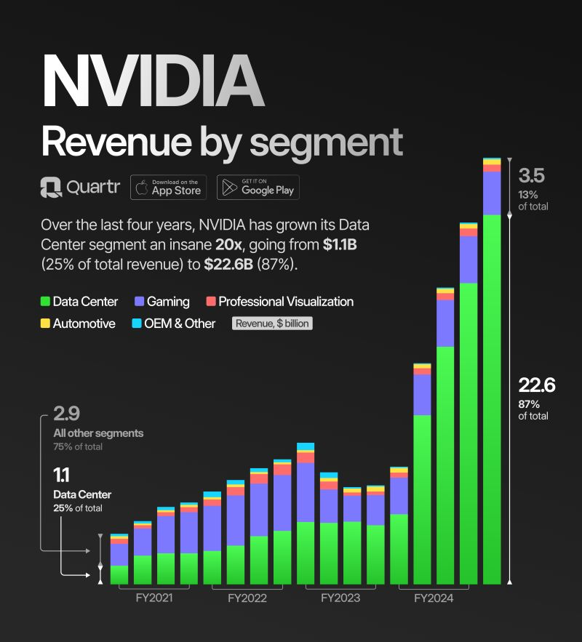
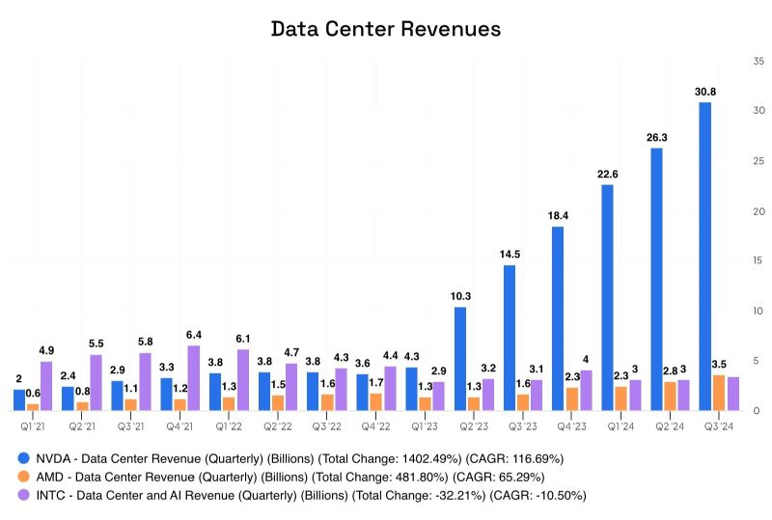
GPUs have risen together with AI

Slide 39
How does a GPU differ from a many-core CPU?
CPU: Follows the Single instruction, multiple threads (SIMT) execution model. Asynchronous programming model where threads are executed independently
GPU: High data throughput and massive parallel computing: a GPU consist of hundreds of cores performing the same operation on multiple data items in parallel.
GPU architectures are built around a scalable array of Streaming Multiprocessors (SM). Each SM in a GPU is designed to support concurrent execution of hundreds of threads
Lower clock speeds, higher latencies, higher throughput, lower power per performance

Slide 40
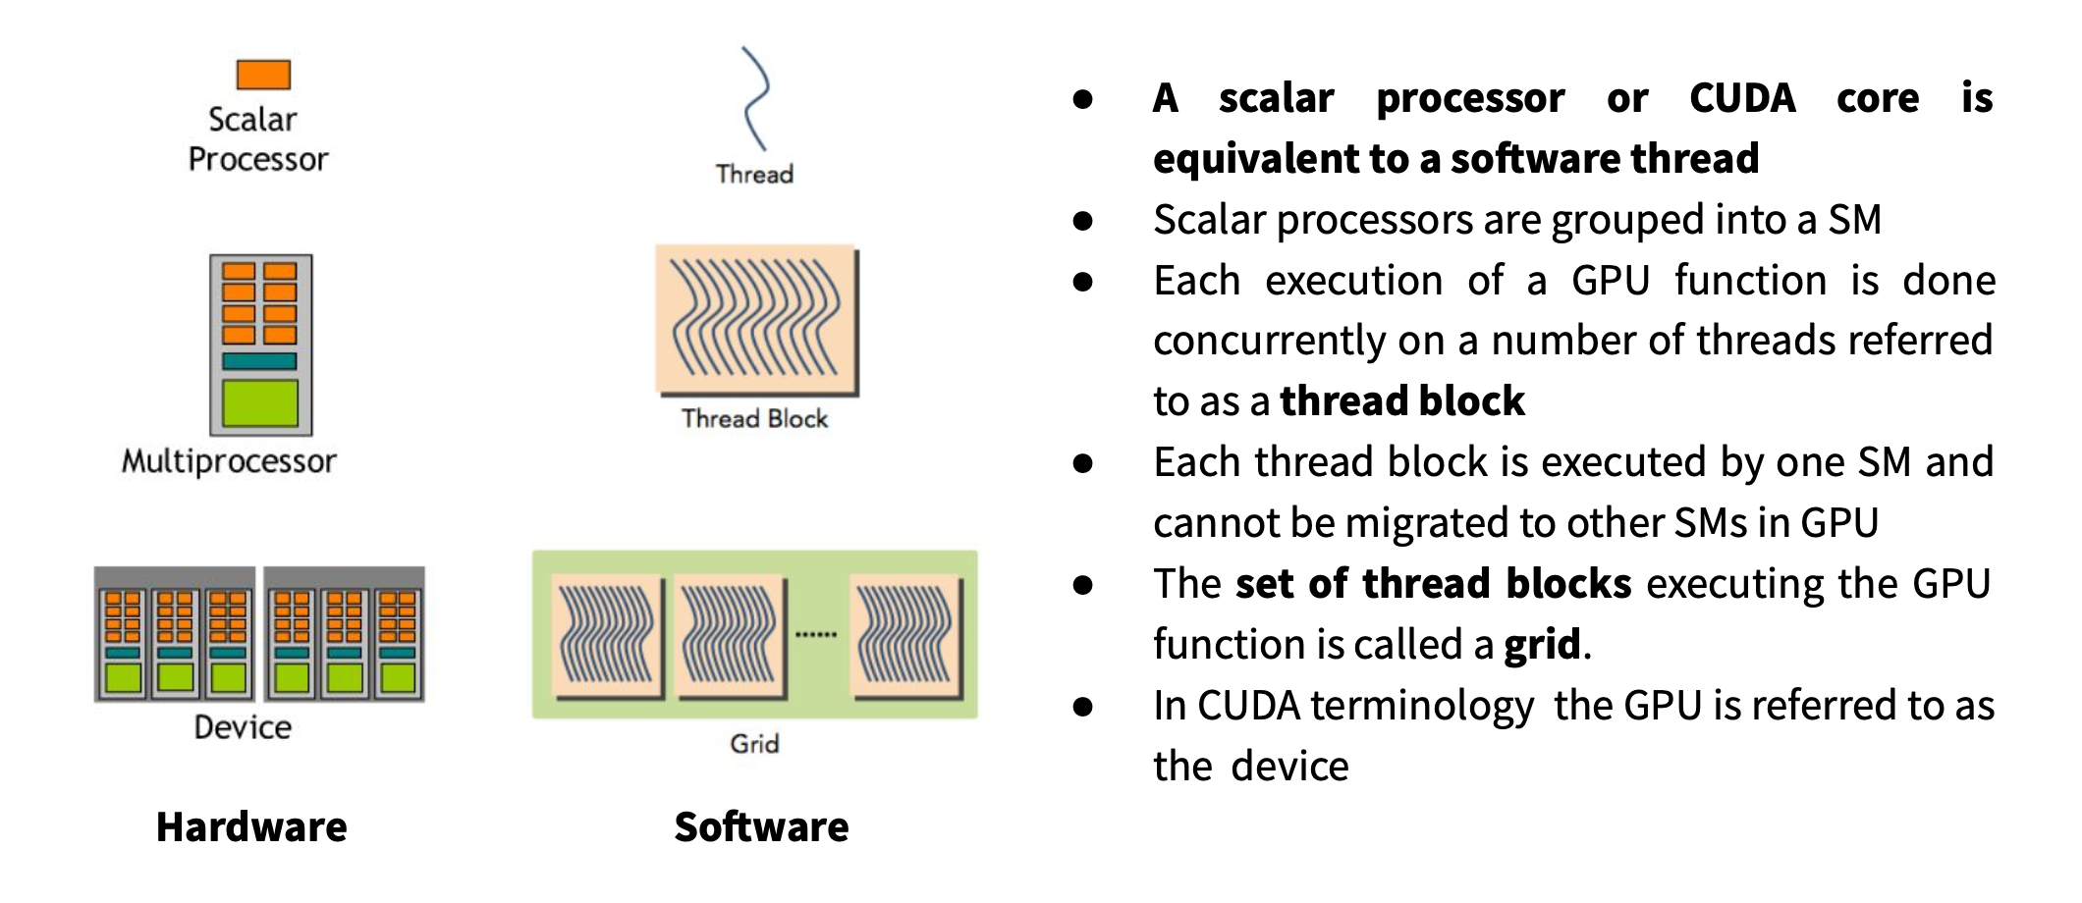
Hardware to software

Slide 41
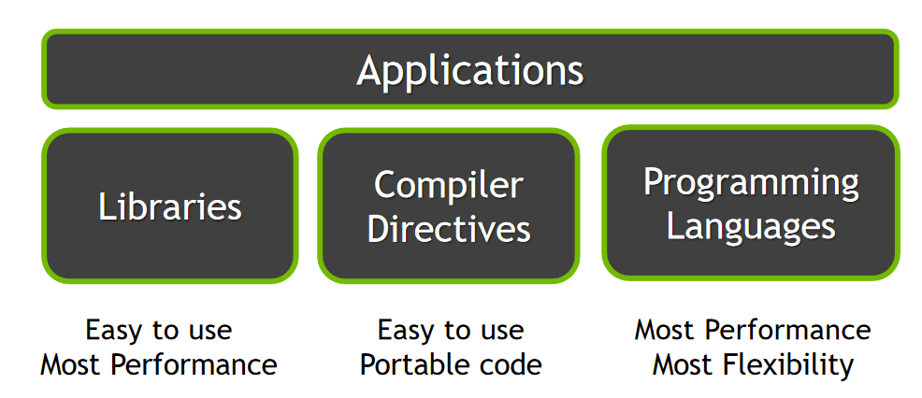
Software for accelerator hardware

Slide 42
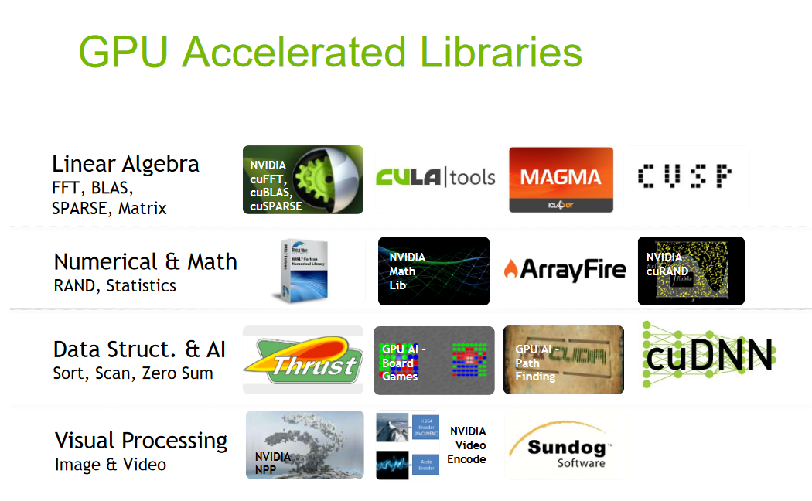

Slide 43
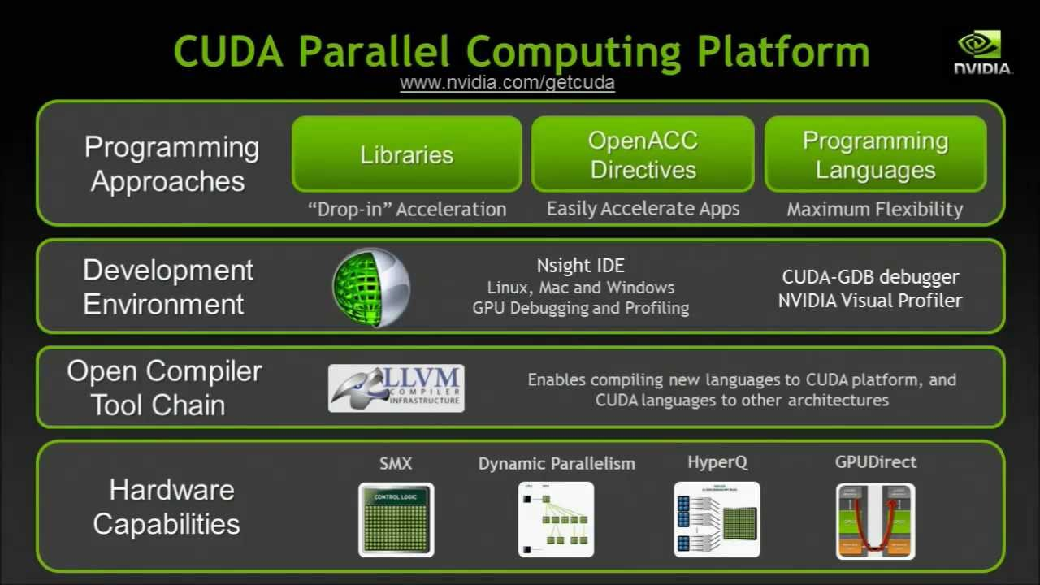
Nvidia GPU programming: CUDA

Slide 44
To effectively use such a high thread count, “kernels” must be identified and sent to the accelerator to compute
The kernel expresses the portion of the application that is parallelizable
On a NVIDIA GPU: it will be executed in parallel by diﬀerent CUDA threads
Linear algebra is the classic example
Large arrays allocated in memory shared across multiple (many) cores/threads simultaneously
Each thread operates on a smaller portion of these arrays
Avoid conflicts and synchronization points between threads
Some intermediate variables may be computed on multiple threads
Extra calculations can keep threads synchronized

Slide 45
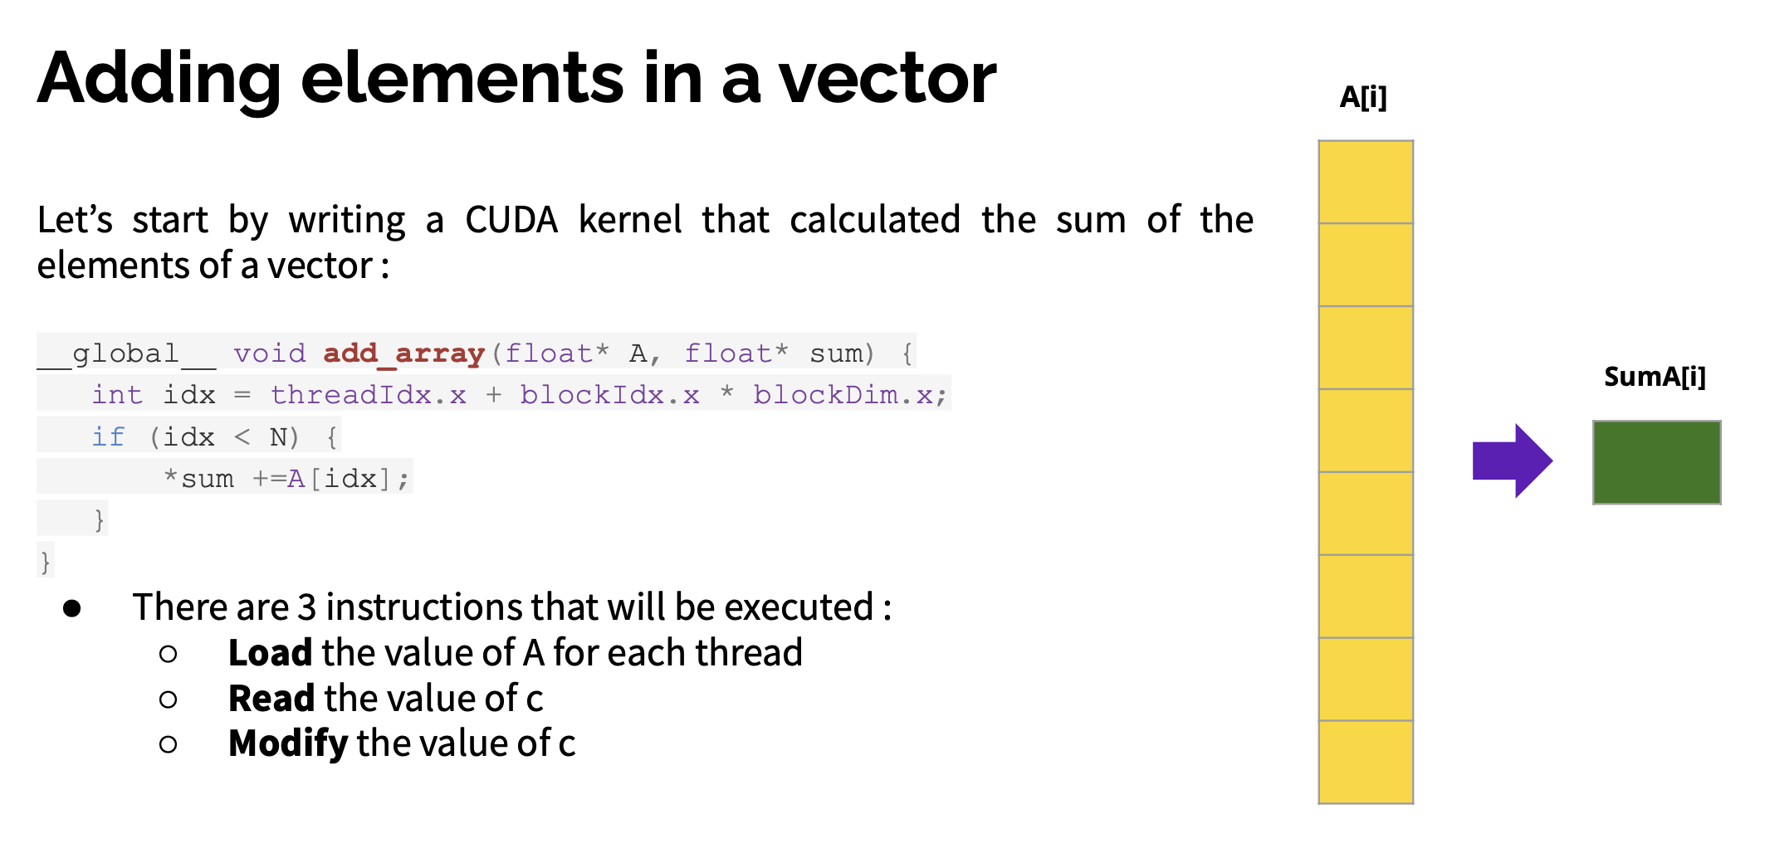
A simple CUDA example?
What goes wrong here?

Slide 46
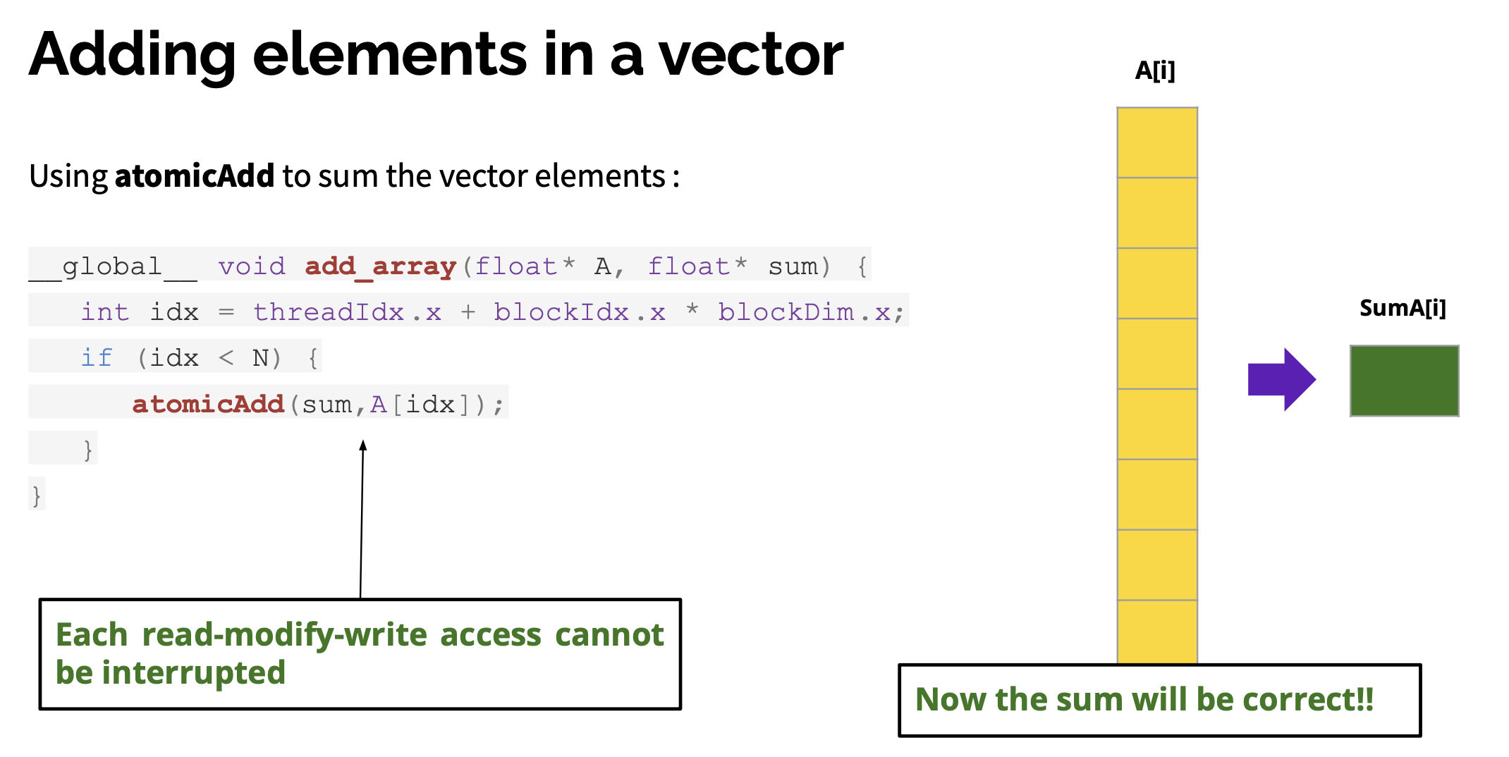
Extra care is needed any time a thread writes to shared memory

Slide 47
Programming model
There is no magic compiler flag that makes your code run in parallel. So your approach really depends on what you are doing and where you intend to run.
You must design from the start for parallelism
I can’t be exhaustive today about how to do this… Let me talk about a few examples

Slide 48
Memory bandwidth and data movement
To do a calculation on a GPU, all needed data must be copied to the GPU (eg, host to device transfer)
GPU memory bandwidth is 100s or 1000s of GB/second. However this can be a limitation:
If your compute kernel is too small
If your application needs to frequently move data back and forth between the device and host.
Common tricks:
Dimensionality reduction
Efficiently representations (eg, sparse matrices)
Building a series of kernels that can be performed without intermediate data transfer (even if one might be less efficient on a GPU by itself)

Slide 49
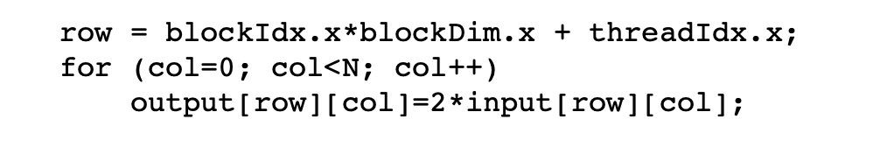
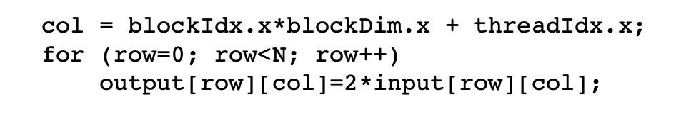
Which code results in more a performant parallel application? (independently of if a GPU, vector CPU, etc)
For GPUs:
Maximum bandwidth is when data for multiple threads can be loaded in a single transaction
This happens if data access patterns are ”close enough”. Eg, if 16 consecutive threads all access data from within the same memory segment.
This condition is met when consecutive threads read consecutive memory addresses. If not, memory accesses are serialized, significantly degrading performance.

Slide 50
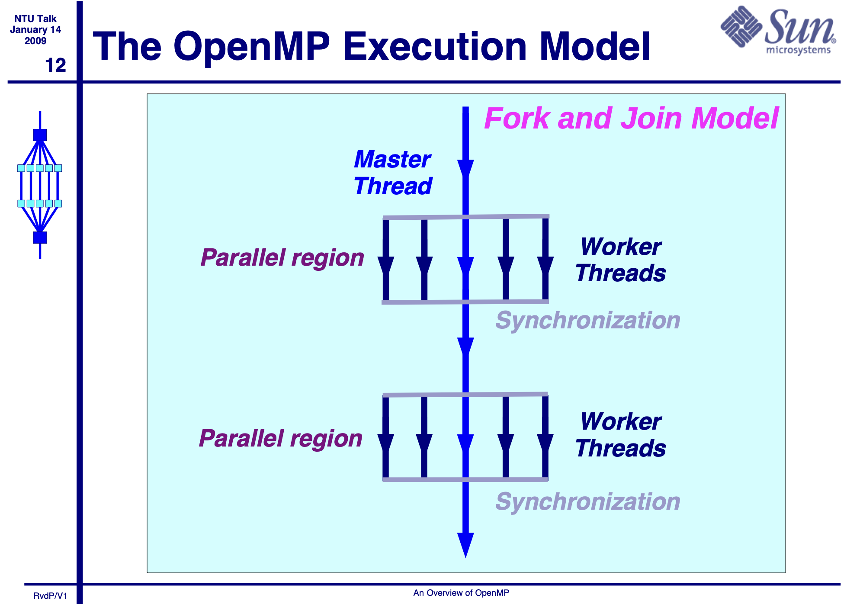
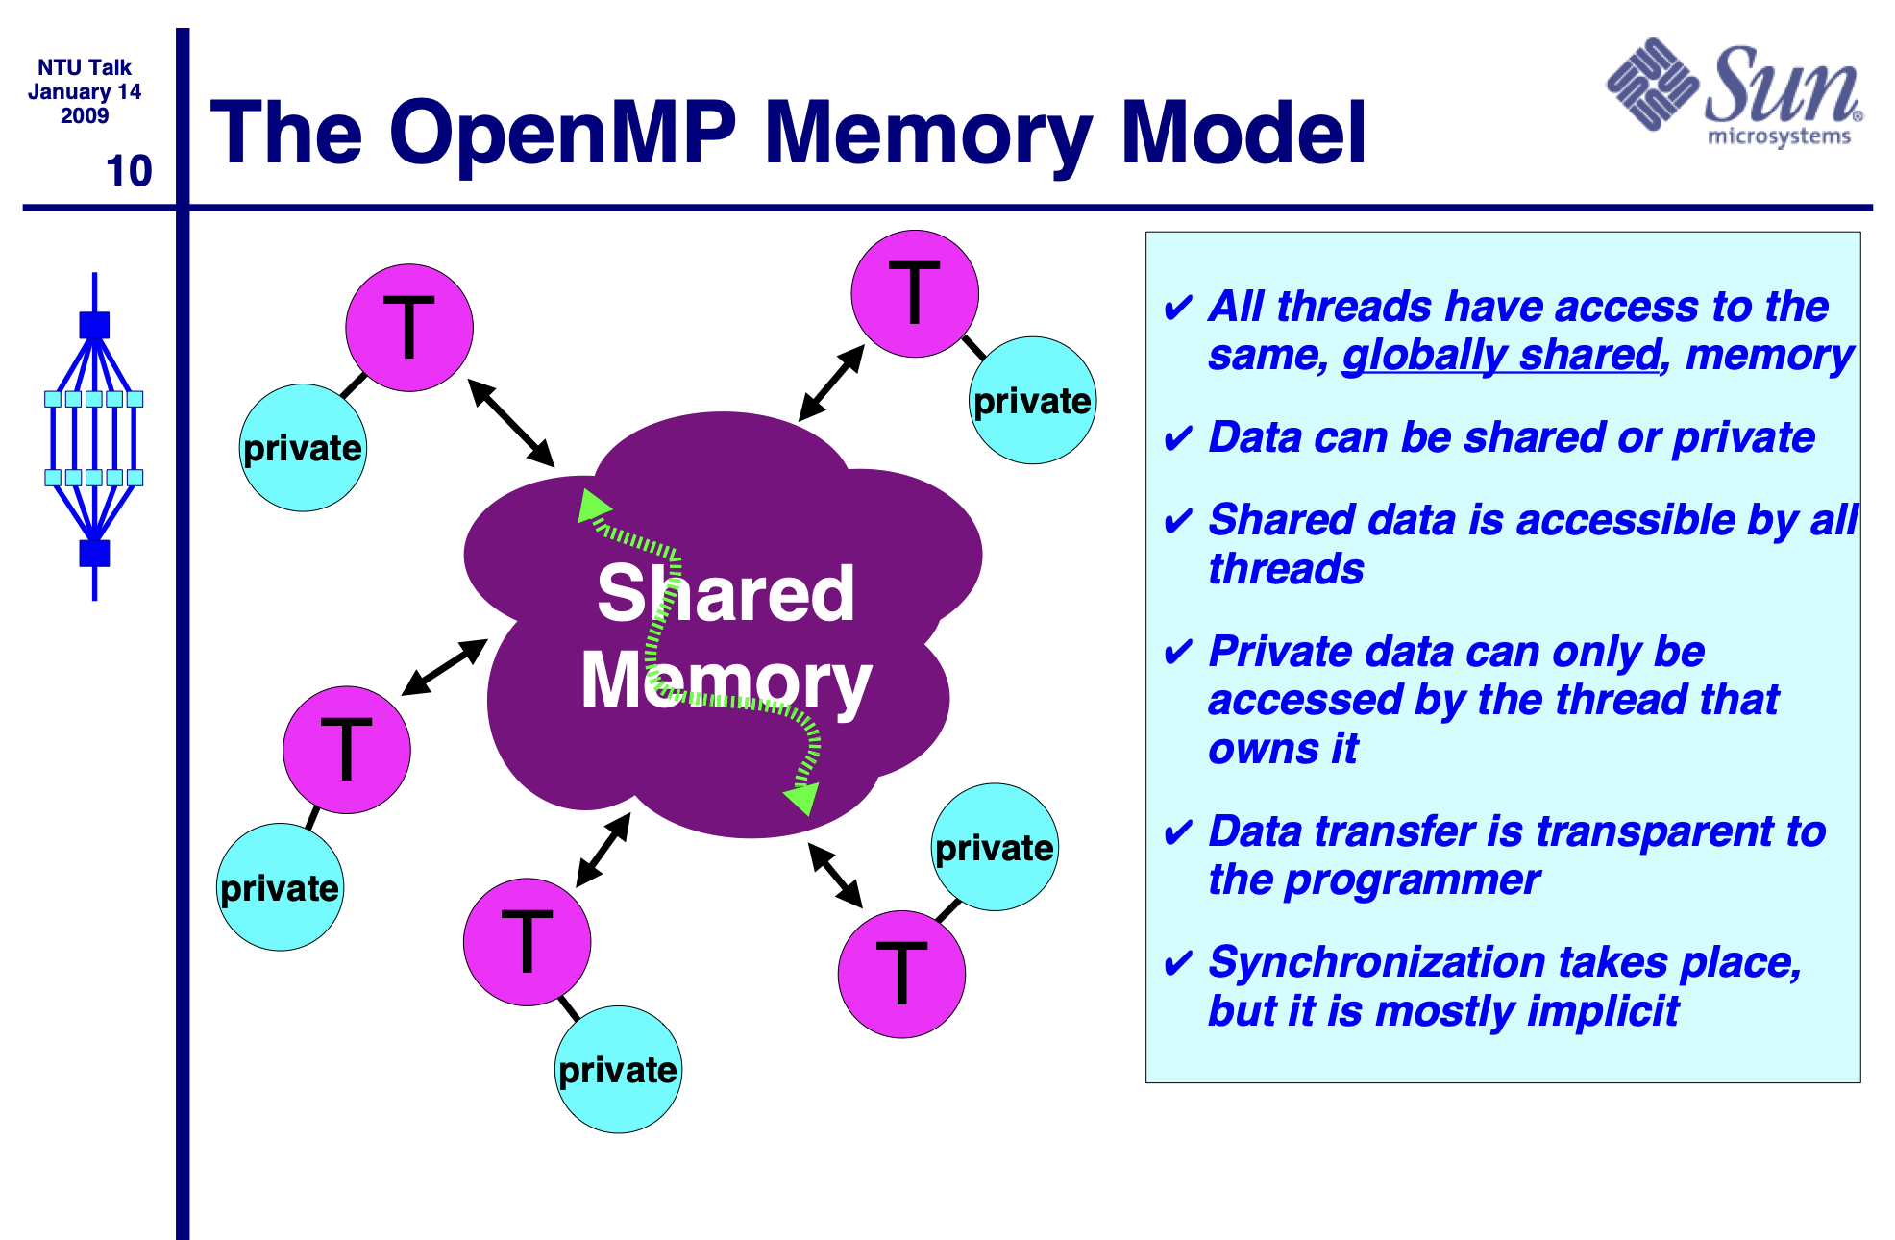
Tools and Libraries: OpenMP
The OpenMP API supports multi-platform shared-memory parallel programming in C/C++ and Fortran. The OpenMP API defines a portable, scalable model with a simple and flexible interface for developing parallel applications on platforms from the desktop to the supercomputer. (https://www.openmp.org)

Slide 51
Tools and Libraries: std::thread
// thread example
#include <iostream> // std::cout
#include <thread> // std::thread
void foo() { // do stuff... }
void bar(int x) { // do stuff... }
int main() {
std::thread first (foo); // spawn new thread that calls foo()
std::thread second (bar,0); // spawn new thread that calls bar(0)
std::cout << "main, foo and bar now execute concurrently...\n";
// synchronize threads:
first.join(); // pauses until first finishes
second.join(); // pauses until second finishes
std::cout << "foo and bar completed.\n";
return 0;
}

Slide 52
Similarly in python….
import threading
def print_cube(num):
print("Cube: {}" .format(num * num * num))
def print_square(num):
print("Square: {}" .format(num * num))
if __name__ =="__main__":
t1 = threading.Thread(target=print_square, args=(10,))
t2 = threading.Thread(target=print_cube, args=(10,))
t1.start()
t2.start()
t1.join()
t2.join()
print("Done!")

Slide 53
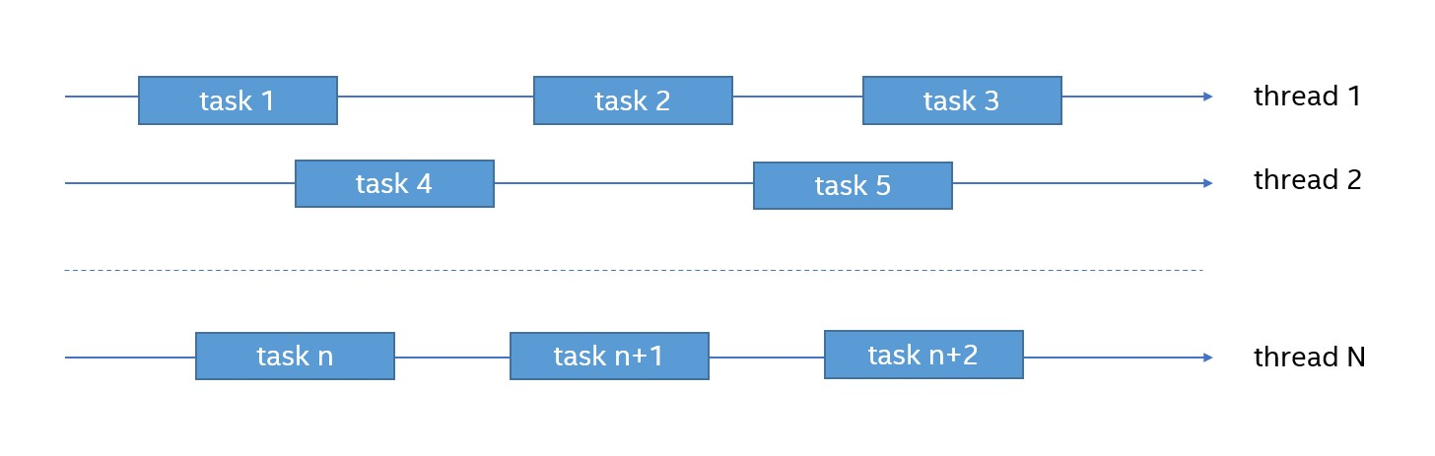
Tools and Libraries: TBB
TBB is well suited for scalable applications that:
Specify logical parallel structure instead of threads.
Emphasize data-parallel programming.
Take advantage of concurrent collections and parallel algorithms.
https://github.com/uxlfoundation/oneTBB

Slide 54
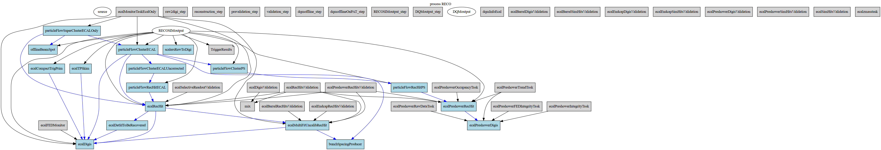
The CMS multi-threaded framework uses TBB to schedule 1000s of tasks per event and to allow multiple events to be processed concurrently
Dependency (task) graph from a small set of CMSSW algorithms

Slide 55
Does heterogeneity mean I need to write code for each different architecture?
Maybe…but doesn’t each GPU vendor has their own API..
Fortunately, there are a number of approaches that aim for performance portability. Eg, to enable portability across accelerators through the abstraction of the underlying levels of parallelism without giving much (too much) performance on any given backend

Slide 56
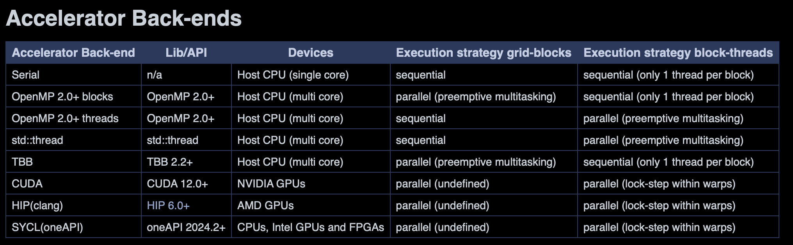
Example: Alpaka
The alpaka library is a header-only C++20 abstraction library for accelerator development. https://alpaka-group.github.io/alpaka/

Slide 57
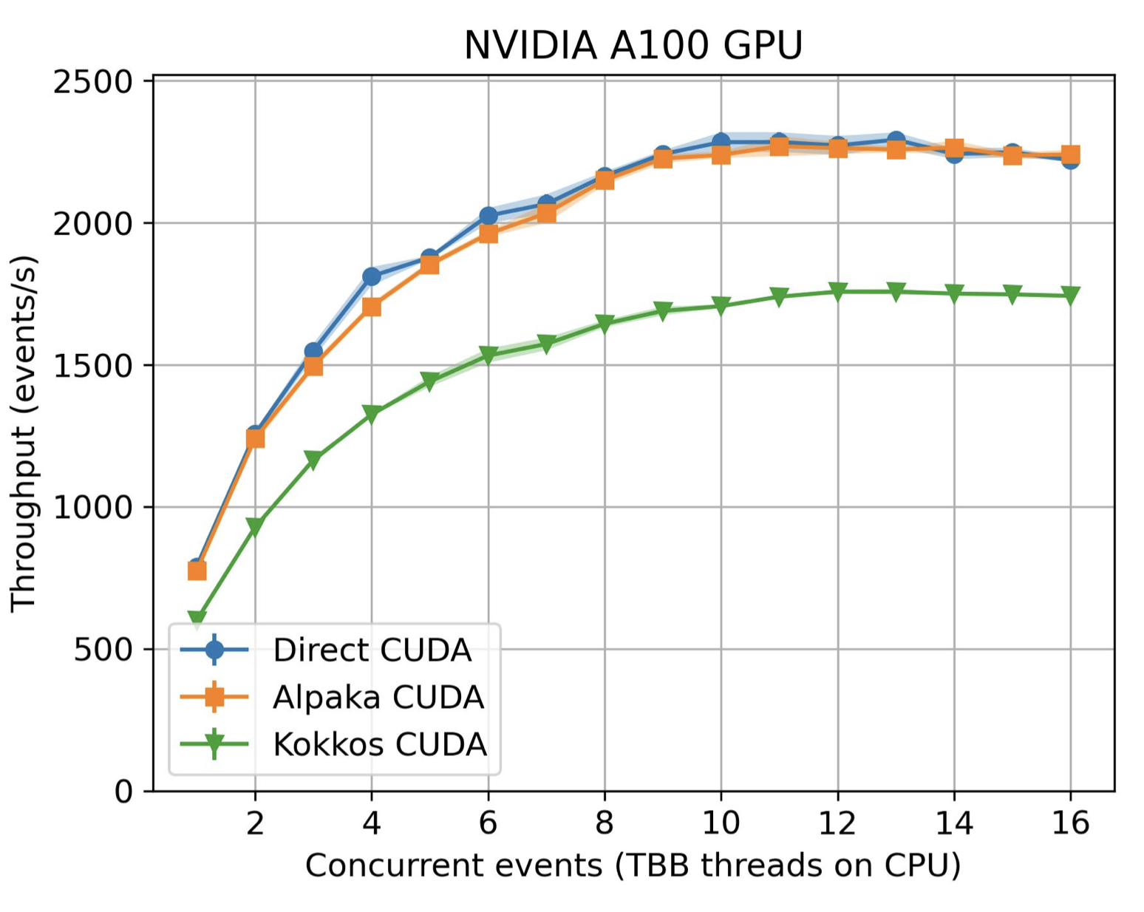
Alpaka performance examples
CMS algorithm evaluation on a CPU comparing a CUDA implementation with an Alpaka implementation running on NVIDIA A100
Essentially no loss of throughput seen (while enabling other backends with the same code)
CHEP presetnation

Slide 58
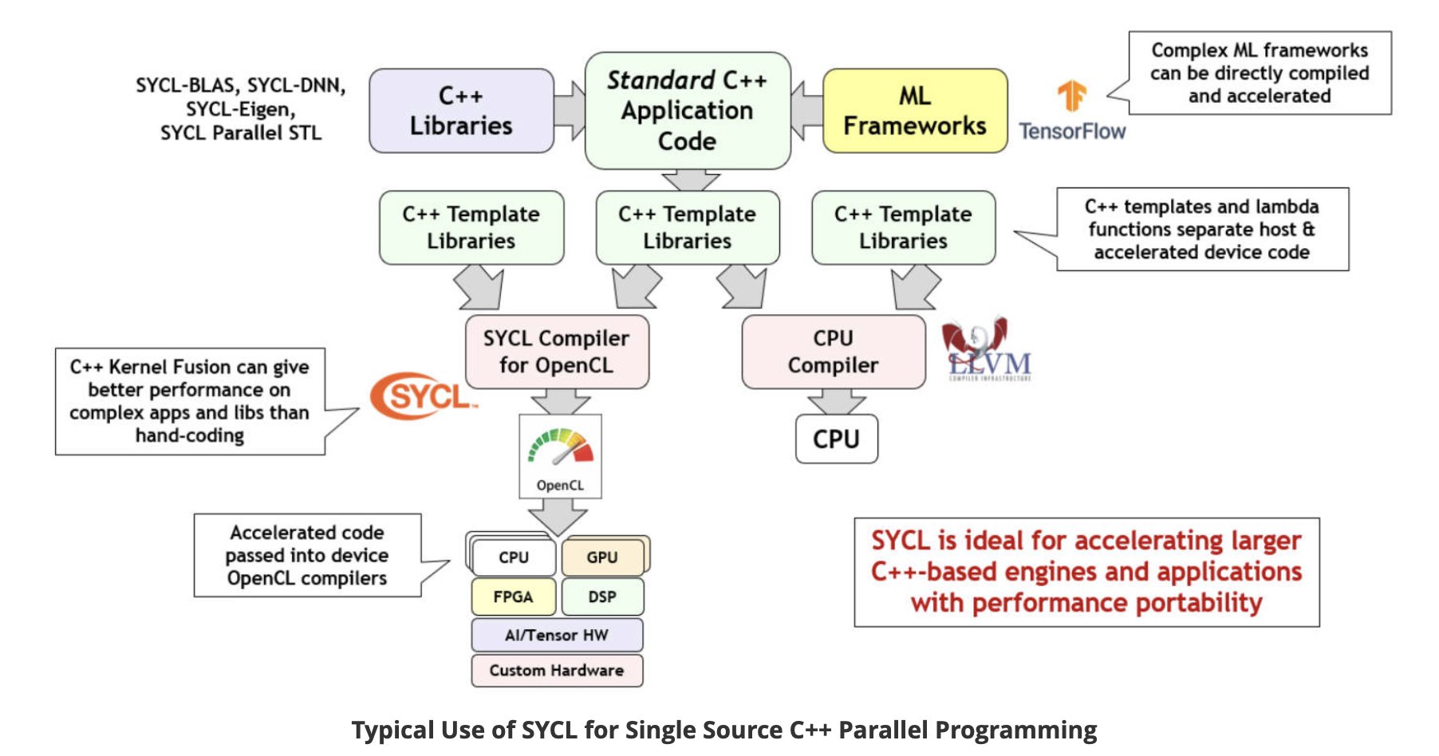
Example: SYCL
https://www.khronos.org/sycl/

Slide 59
SYCL code example..

Slide 60
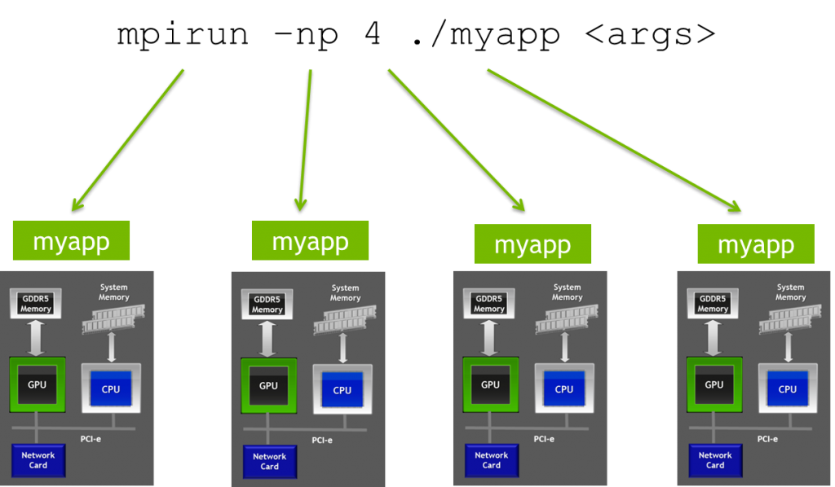
Libraries for scaling codes to large problems: MPI
Message Passing Interface (MPI) is interface defining a model of parallel computing where each parallel process has its own local memory, and data must be explicitly shared by passing messages between processes.
Using MPI allows programs to scale beyond the processors and shared memory of a single compute server, to the distributed memory and processors of multiple compute servers combined together.

Slide 61
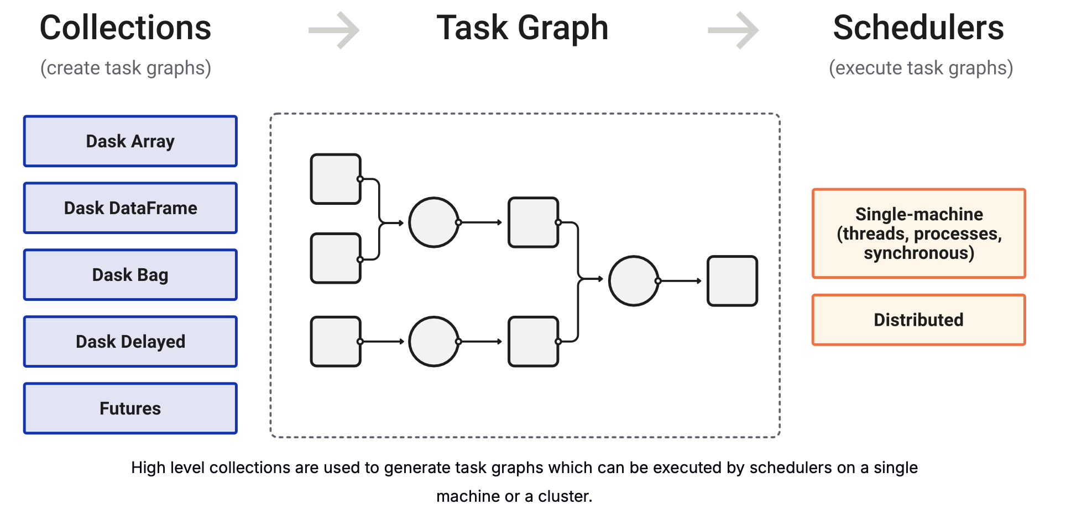
Another library for horizontal scaling but for Python: Dask

Slide 62
Scientific Python on GPUs

Slide 63
Python and GPU
Our introduction to array-oriented programming started by addressing Python's slowness (or the slowness of interactive environments in general).
But GPUs are also best addressed in an array-at-a-time fashion: the memory layout explicitly favors arrays over objects addressed by pointers or references (even in C++).
It should not be a surprise, then, that Python's GPU libraries are array libraries.

Slide 64
Python and ML
Most users of GPUs in Python are using them for Machine Learning (ML).
Since ML libraries are focused on ML, rather than programming in general, they provide an interface that is identical for CPUs and GPUs, usually by a device flag in the array object.
Switching from device="cpu" to device="cuda"simply speeds up the calculation by an order of magnitude with no other changes.
In this lesson, we'll focus on GPU programming in which the differences from CPU programming are visible.

Slide 65
Most libraries specifically address CUDA, Nvidia's brand of GPU programming
This reflects the very tight monopoly Nvidia has on GPUs for general-purpose programming.
CuPy has experimental support for AMD but Numba deprecated support for AMD due to lack of community interest.
There are Python projects that support OpenCL, Vulkan, Kokkos, and SYCL.
Unfortunately, this excludes many laptops, including all MacOS: CUDA is something you'll more likely use on a data center than a laptop.

Slide 66
Installing a working version of CUDA can be hard, as it depends strongly on the operating system and GPU hardware
The GPU driver must be installed in the operating system (Windows or Linux) and not with any Python package installers (pip, conda, uv, pixi). You might get it directly from Nvidia or through the operating system's package installer (such as apt for Ubuntu).
The CUDA compiler and its libraries are distinct from the device driver, and they can be installed with conda. The story is more complicated for CUDA 11, but for CUDA 12, just include cuda-version=12 in the list of packages to install.
Nvidia publishes a table of version compatibility between GPU hardware, drivers, and CUDA packages.

Slide 67
Lets have a look at our setup
Two useful shell commands:
nvidia-smi is Nvidia’s tool to find out what hardware is installed and what it is doing
Numba comes with a numba -s command line tool to print the versions of everything: incompatibilities between driver and CUDA package can be found here.

Slide 68
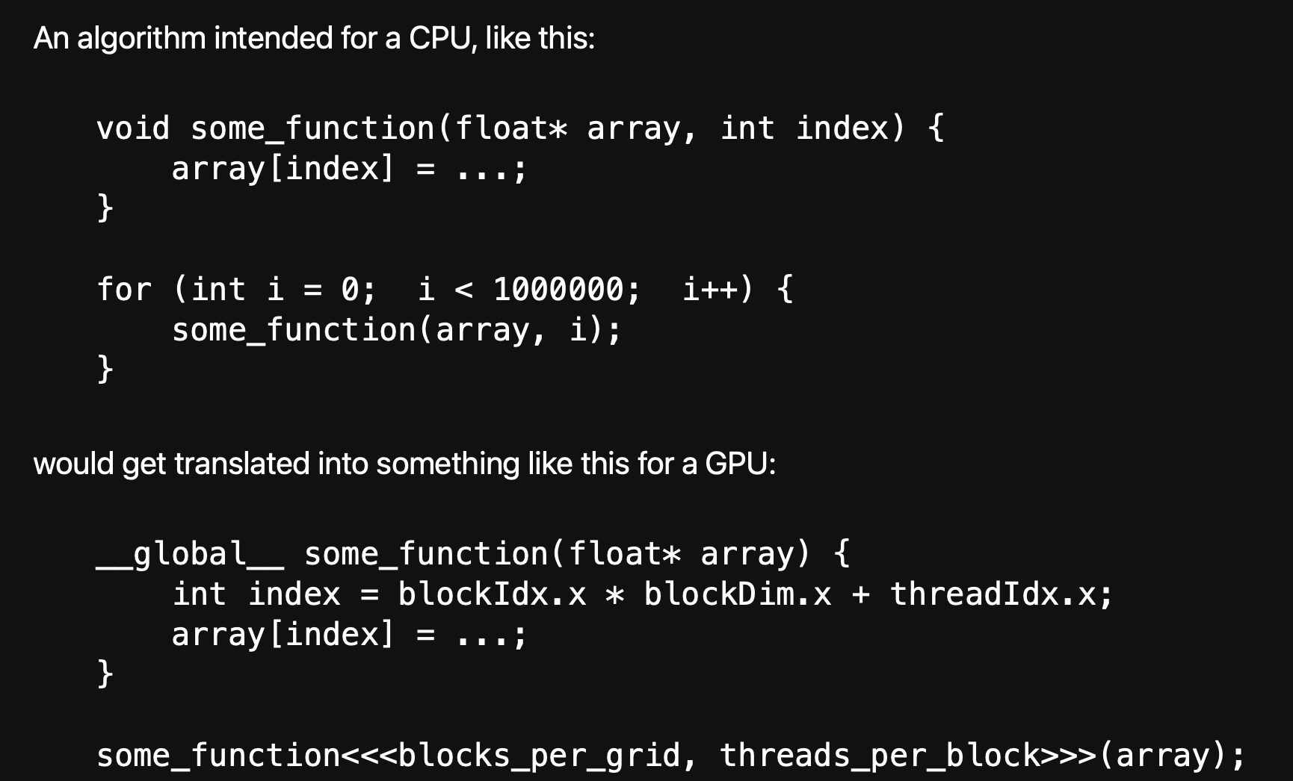
Programming model
The explicit iteration over elements of an array on the CPU is replaced by a GPU "kernel" function that applies to just one array element
Each kernel-execution "thread" might run at any time.
Execution is organized into "blocks": threads within a block run at the same time on shared resources, and the GPU schedules block execution in a way that keeps its streaming multiprocessors busy.
The array must already be in the GPU's global memory.

Slide 69
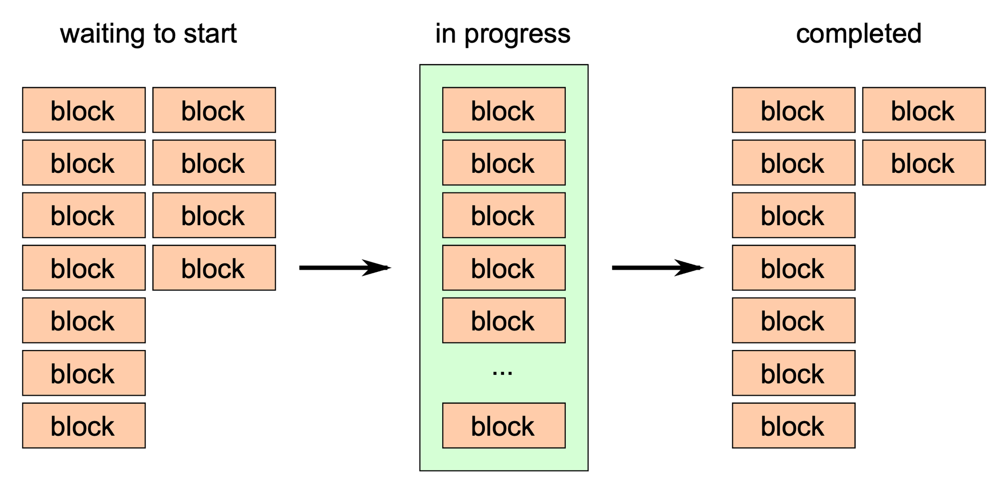

Slide 70
The blocks_per_grid and threads_per_block are units of work—they control how computations are scheduled on the GPU—not units of array allocation. However, for 1-dimensional data, it's often best to define them in terms of the array size:
This minimizes the number of blocks needed to make sure that each array element is updated by exactly one thread.

Slide 71
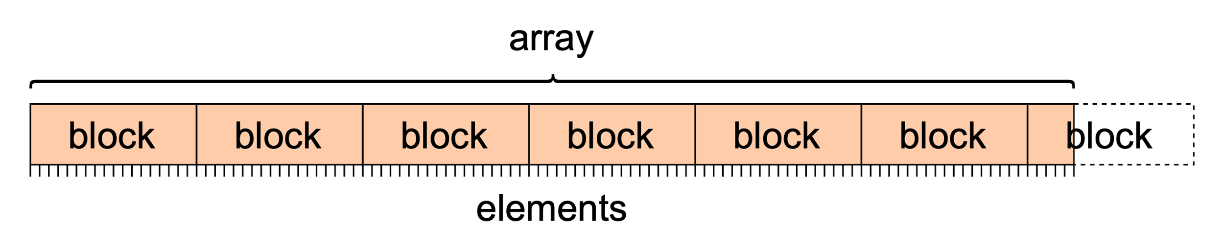
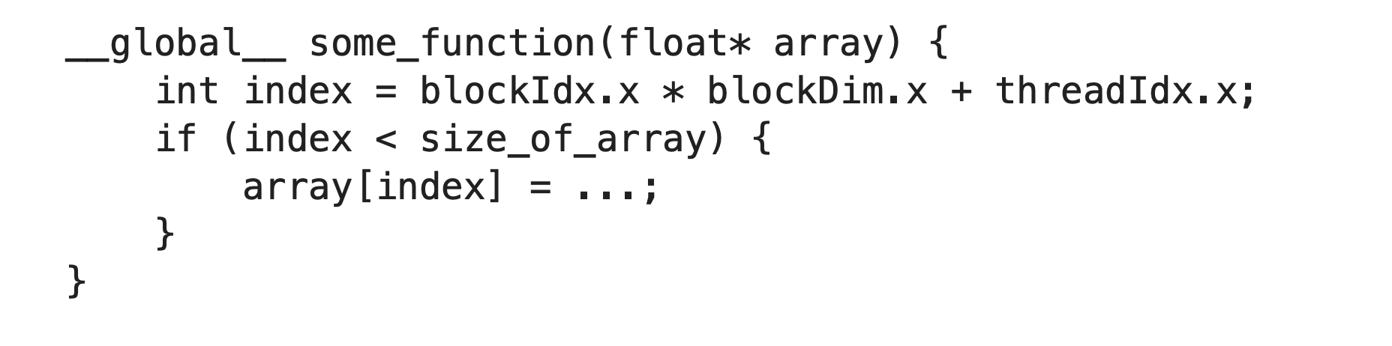
If the `size_of_array` doesn't fit neatly into an integer number of blocks, a few threads will be wasted. To make sure that they don't update uninitialized data, you usually need to check for an excess in the kernel function:

Slide 72
Now for more examples to help get you started with Python libraries on GPUs

Slide 73
Wrap up
Parallel programming libraries exist for any language and some abstract away the underlying heterogeneous hardware
BUT: you can not avoid formulating your algorithms to be efficient running in parallel – be it as independent tasks or data parallel
Use libraries where you can. They will result in more efficient than code you (or I) can write

Slide 74
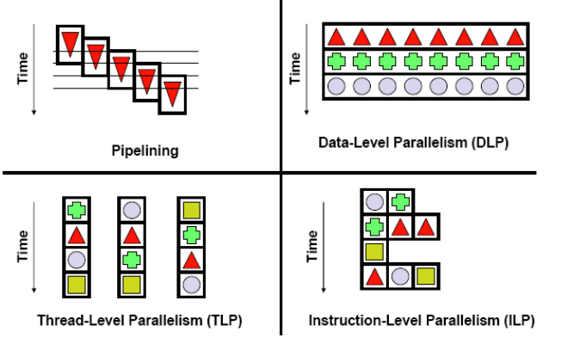
Types of parallelism

